Slide 1




Web Server & CGI
Communication between Client & Server
Java Web Dev Basics
SoftUni Team
Technical Trainers
Software University
http://softuni.bg

Slide 2
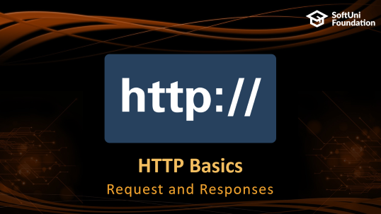



Table of Contents

Slide 3
Questions
sli.do #java-web

Slide 4

HTTP Basics
Request and Responses

Slide 5


Hyper Text Transfer Protocol
Request
Response
HTTP
HTTP
TCP
TCP
IP
IP
Ethernet
Media (wires / air / fiber)
Ethernet
Notes:
HTTP == Hyper Text Transfer Protocol
Client-server protocol for transferring Web resources (HTML files, images, styles, scripts, data, etc.)
The widespread protocol for Internet communication today
Request-response model (client requests, server answers)
Text-based format (human readable)
Relies on unique resource URLs
Provides resource metadata (e.g. encoding)
Stateless (cookies and Web storages can overcome this)

Slide 6
HTTP Request Methods
HTTP defines methods to indicate the desired action to be performed on the identified resource
Method | Description
GET | Retrieve / load a resource
POST | Create / store a resource
PUT | Update a resource
DELETE | Remove a resource

Slide 7
HTTP Conversation: Example
GET /courses/javascript HTTP/1.1
Host: www.softuni.bg
User-Agent: Mozilla/5.0
<CRLF>
HTTP request:
HTTP response:
The empty line denotes the end of the request header
HTTP/1.1 200 OK
Date: Mon, 5 Jul 2010 13:09:03 GMT
Server: Microsoft-HTTPAPI/2.0
Last-Modified: Mon, 12 Jul 2014 15:33:23 GMT
Content-Length: 54
<CRLF>
<html><title>Hello</title>
Welcome to our site</html>
The empty line denotes the end of the response header

Slide 8



HTML Forms
Form Method and Action

Slide 9


HTML Forms - Action Attribute
Defines where to submit the form data:
<form action="home.html">
<input type="submit" value="Go to homepage"/>
</form>

Slide 10
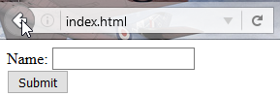
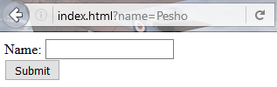
HTML Forms – Method Attribute
Specifies the HTTP method to use when sending form-data
<form method="get"> Name: <input type="text" name="name"> <br>
<input type="submit" value="Submit">
</form>
The form data is in the URL

Slide 11
HTML Forms – Method Attribute (2)
<form method="post"> Name: <input type="text" name="name"> <br>
<input type="submit" value="Submit">
</form>
POST http://localhost/index.html HTTP/1.1
Host: localhost
Content-Type: application/x-www-form-urlencoded
Content-Length: 10
name=Pesho
Headers will be explained later
HTTP request body holds the form data

Slide 12
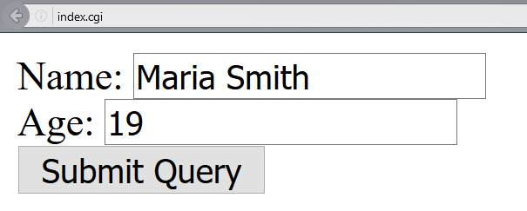
URL Encoded Form Data – Example
<form method="post">
Name: <input type="text" name="name"/> <br/>
Age: <input type="text" name="age"/> <br/>
<input type="submit" />
</form>
POST http://localhost/cgi-bin/index.cgi HTTP/1.1
Host: localhost
Content-Type: application/x-www-form-urlencoded
Content-Length: 23
name=Maria+Smith&age=19
File uploads are not supported

Slide 13

URL
Uniform Resource Locator

Slide 14
Uniform Resource Locator (URL)
http://mysite.com:8080/demo/index.php?id=27&lang=en#lectures
Protocol
Host
Port
Path
Query String
Fragment
URL is a formatted string, consisting of:
Protocol for communicating (http, ftp, https...) – HTTP in most cases
Host or IP address (www.softuni.bg, gmail.com, 127.0.0.1, web)
Port (the default port is 80) – a number in range [0…65535]
Path (/forum, /path/index.php)
Query string (?id=27&lang=en)
Fragment (#lectures) – used on the client to navigate to some section

Slide 15
URL Encoding
URLs are encoded according RFC 1738:
Safe URL characters: [0-9a-zA-Z], $, -, _, . , +, *, ', (, ), ,, !
All other characters are escaped by:
Space is encoded as "+" or "%20"
Example:
URL-encoded string:
Char | URL Encoding
space | %20
щ | %D1%89
" | %22
# | %23
$ | %24
% | %25
& | %26
%[character hex code]
Наков-爱-SoftUni
%D0%9D%D0%B0%D0%BA%D0%BE%D0%B2-%E7%88%B1-SoftUni

Slide 16
Valid and Invalid URLs – Examples
Some valid URLs:
Some invalid URLs:
http://www.google.bg/search?sourceid=navclient&ie=UTF-8&rlz=1T4GGLL_enBG369BG369&q=http+get+vs+post
http://bg.wikipedia.org/wiki/%D0%A1%D0%BE%D1%84%D1%82%D1%83%D0%B5%D1%80%D0%BD%D0%B0_%D0%B0%D0%BA%D0%B0%D0%B4%D0%B5%D0%BC%D0%B8%D1%8F
Should be: ?q=C%23+.NET+4.0
http://www.google.bg/search?&q=C# .NET 4.0
Should be: ?q=%D0%B1 %D0%B8%D1%80%D0%B0
http://www.google.bg/search?&q=бира

Slide 17

HTTP
Tools for Developers

Slide 18
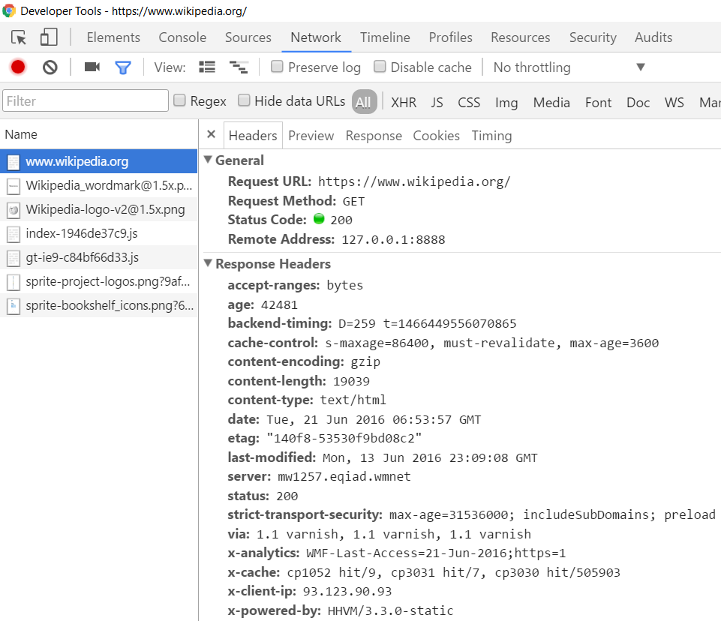
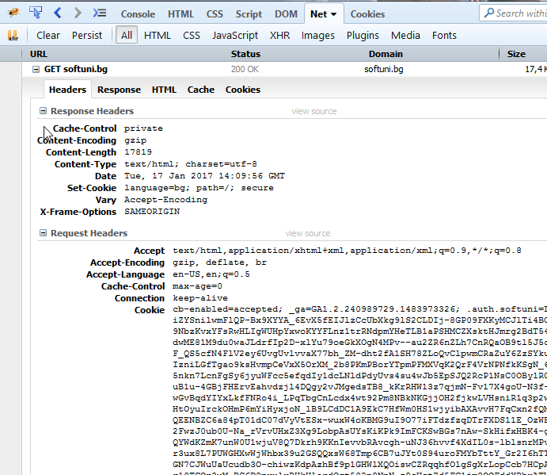
HTTP Tools for Developers - Browser
Chrome Developer Tools
Firebug

Slide 19


HTTP Tools for Developers - Browser (2)
Postman - Chrome
RESTClient - Firefox

Slide 20
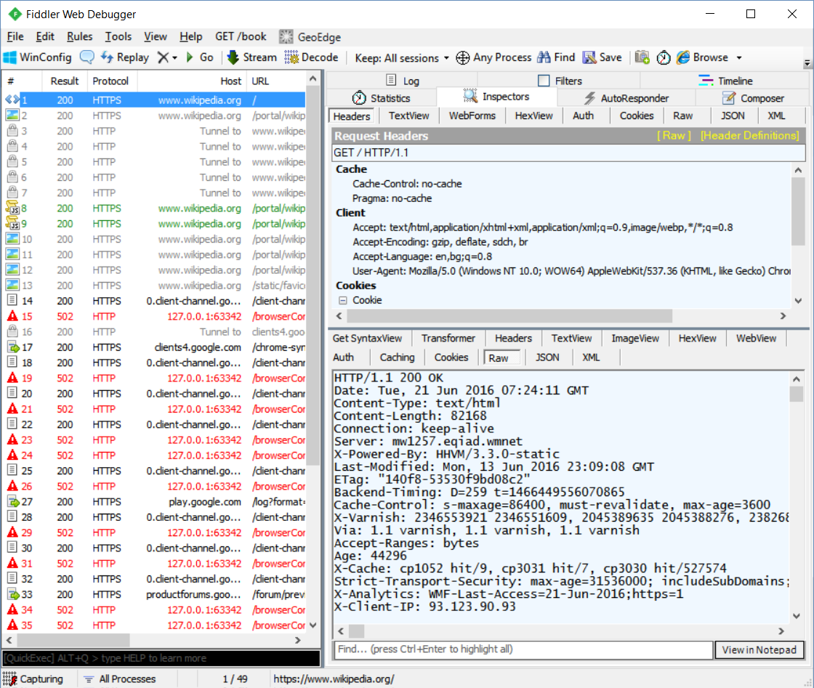
HTTP Tools for Developers - Desktop
Fiddler

Slide 21



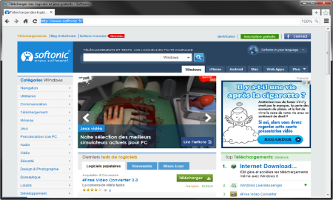
Web Server

Slide 22
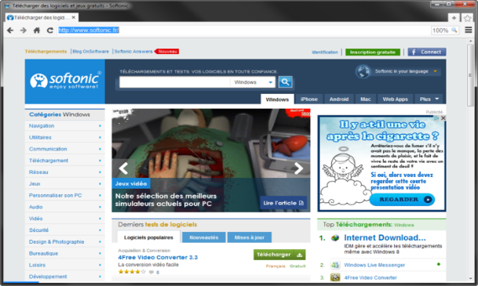



What is a Web Server?
Computer system that processes requests via HTTP, the basic network protocol
Web Client
Web Server
Communication

Slide 23
Web Server Work Model
Web Server
Web Resources
Web Client
Request
Protocol
Response
HTML, PDF, JPG…
Protocols:
HTTP FTP WebSocket
Protocol
Host
Port
Resource
URL
http://localhost:80/softuni.jpg

Slide 24



Web Server Work Model (2)
Web Server
Technology
Web Client
Request
Protocol
Response
Web Resources
Database
HTML, PDF, JPG…

Slide 25


Web Server Work Model (3)
Web Server
Technology
Spring
Web Resources
Database
HTML, PDF, JPG…

Slide 26
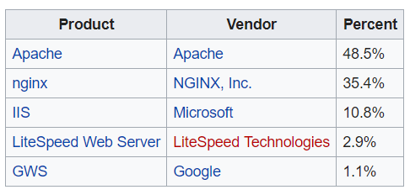


Most Popular Web Servers (W3Techs)

Slide 27
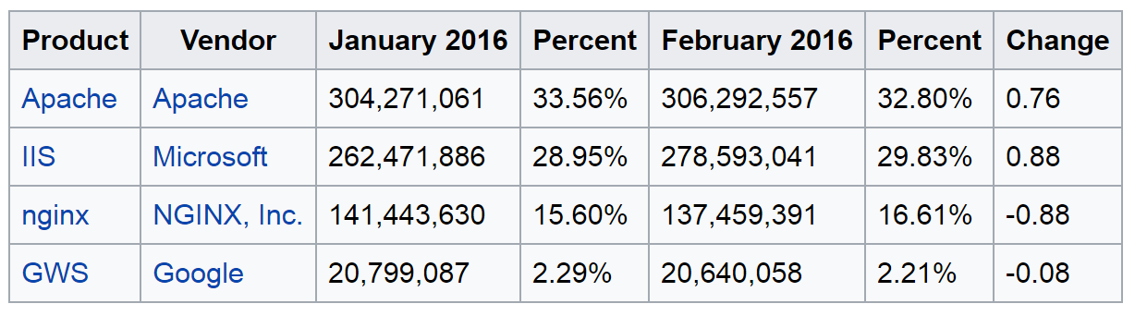
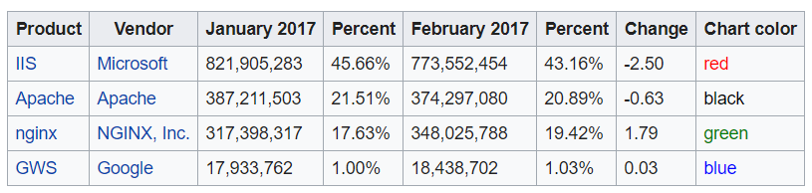
Most Popular Web Servers (NetCraft)

Slide 28

CGI

Slide 29


What is CGI?
Standard protocol for web servers to interface with executable programs that generate web pages dynamically
Web Client
Web Server
HTTP
CGI
Response

Slide 30
CGI with Java
Cgi.java
public class Test {
public static void main(String[] args) {
String type = "Content-Type: text/html\n\n";
String output =
"<html>" +
"Hi from CGI!" +
"</html>";
System.out.println(type);
System.out.println(output);
}
}

Slide 31
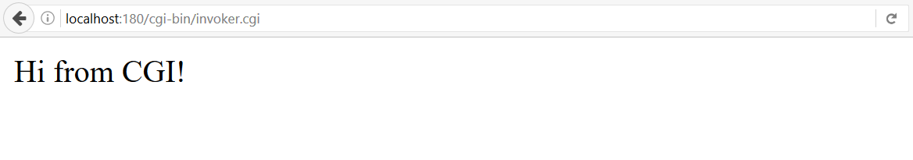
CGI with Java (2)
invoker.cgi
Unix shell
Cyrillic Encoding
#!C:\cygwin64\bin\bash.exe
chcp 65001
java -Dfile.encoding=UTF8 -cp ./ Cgi
.class
Command
System Property
Place for Dependencies
CGI Script
Response from java

Slide 32
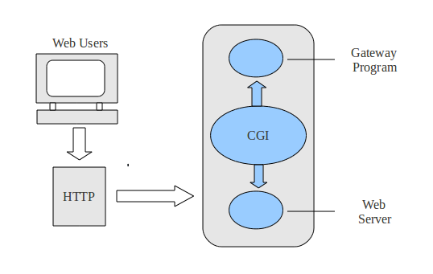
CGI (Live Demo)

Slide 33



Summary
Web Servers process requests via HTTP
Their primary function is to store, process and deliver web content to clients
What is CGI? (Common Gateway Interface)
What is it used for?

Slide 34







Java Web Dev Basics – Web Server & CGI
https://softuni.bg/courses/java-web-development-basics

Slide 35
License
This course (slides, examples, demos, videos, homework, etc.) is licensed under the "Creative Commons Attribution-NonCommercial-ShareAlike 4.0 International" license

Slide 36





Trainings @ Software University (SoftUni)
Software University – High-Quality Education, Profession and Job for Software Developers
softuni.bg
Software University Foundation
http://softuni.foundation/
Software University @ Facebook
facebook.com/SoftwareUniversity
Software University Forums
forum.softuni.bg

